Slide 1
Reservoirs
Workshop for Water Sector Team
08/10/2018 to 12/10/2018

Slide 2
Design process
Assess the area
→ Identification of best network coverage (chapter3)
Sketch the design
→ Chapter 4
Choice of a type of network and repartition
→ Chapter 5
Calculate the theoretical repartition of the flow
→ Chapter 6
Calculate the real DB repartition
→ Distribution Box repartition
Calculate the reservoir volume
→ Reservoir size calculation
Caclulate the pipeline diameter
→ Pipeline design

Slide 3
Reservoirs
Store water when faucet of WP is closed
Night storage
Useless to calculate storage for more than 14 h

Slide 4
New Approach Construction of one Reservoir for one WP
Advantage | Disadvantage
Common reservoir
Sharing the volume above the partition | On steep slope to much pressure on faucets
On spot
Each community manage its storage Easier to understand Overflow goes to cattle trough Quick and easy to build with mould | No sharing the volume above the partition

Slide 5
Reservoir is close to WP If possible above

Slide 6
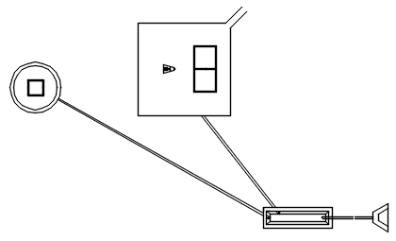
Reservoir overflow to cattle through

Slide 7
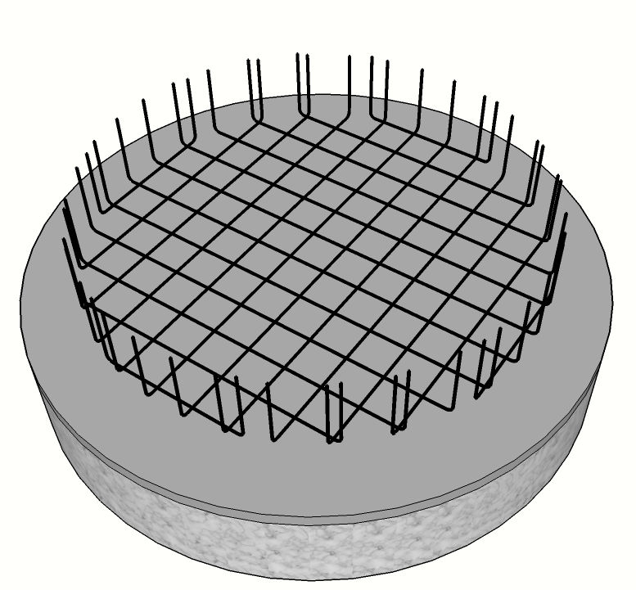
Concrete Reservoir construction Extremely durable
Foundation
Slab reinforcement
Slab
Placing inside mould
Vertical reinforcement
Circular reinforcement
Casting the wall
Wall finished
Reservoir finished

Slide 8
Total daily needs
Amount of water required to supply the population of the WP:
$\text{Total} \text{daily} \text{Needs}\text{ (}\text{l}\text{/}\text{day}\text{) }\text{=}\text{nb} \text{of} \text{HH}\text{ × }\text{Need}\text{(}\text{l}\text{/}\text{pers}\text{/}\text{day}\text{)×}\text{nb} \text{of} \text{pers} \text{per} \text{HH}$
$\text{Total} \text{daily} \text{Needs}\text{ (}\text{l}\text{/}\text{day}\text{) }\text{= }\text{nb} \text{of} \text{HH}\text{ ×}\text{ 15 (}\text{l}\text{/}\text{pers}\text{/}\text{day}\text{) }\text{x}\text{ 6 (}\text{pers}\text{/}\text{HH}\text{)}$
$$\text{T}\text{otal} \text{daily} \text{Needs}\text{ (}\text{l}\text{/}\text{day}\text{) }\text{= }\text{nb} \text{of} \text{HH}\text{ ×90 }$$

Slide 9
Daily production
Theoretical flow (in dry season) that will supply the reservoir in one day:
The inlet yield is the flow that is coming out of the DB to supply the community (see DB design)
$\text{Daily} \text{production}\text{ (}\text{l}\text{/}\text{day}\text{) }\text{=} \text{Inlet} \text{yield}\text{ (}\text{l}\text{/}\text{s}\text{) }\text{× }\text{3600 }\text{(}\text{s}\text{/}\text{hr}\text{)}$ x 24 (hr/day)
$$\text{Daily} \text{Production} \text{(}\text{l}\text{/}\text{day}\text{) }\text{= }\text{inlet} \text{yield}\text{ (}\text{l}\text{/}\text{s}\text{) }\text{x}\text{ 86400}$$

Slide 10
Daytime production
Theoretical flow (in dry season) that will supply the reservoir during the 10 h of the day:
The inlet yield is the flow that is coming out of the DB to supply the community (see DB design)
$\text{Daytime} \text{production}\text{ (}\text{l}\text{/}\text{day}\text{time}\text{)} \text{=} \text{Inlet} \text{yield}\text{(}\text{l}\text{/}\text{s}\text{)}\text{×} \text{3600 }\text{(}\text{s}\text{/}\text{hr}\text{)}$ x 10 (hr/daytime)
$$\text{Da}\text{ytime} \text{Production} \text{(}\text{l}\text{/}\text{day}\text{time}\text{) }\text{= }\text{inlet} \text{yield}\text{ (}\text{l}\text{/}\text{s}\text{) }\text{x}\text{ 36000}$$

Slide 11
Designer choices
Possible case |  | Designer choices
A | Needs < Daytime production | Open Flow
B | Needs > Daytime production and Needs < Daily production | Reservoir
C | Needs > Daily production | Needs are not covered → Ask your coordinator for help on this design
$${\text{V}}_{\text{Reservoir}}\text{ (}\text{l}\text{) =}\text{Total} \text{daily} \text{needs}\text{ (}\text{l}\text{/}\text{day}\text{) }\text{−} \text{Daytime} \text{production}\text{ (}\text{l}\text{/}\text{day}\text{)}$$

Slide 12
Example: Bisha network
 | WP name | Masana | Bobichwada | Diblecheba | Bobichwada school
 | Nb of HH | 70 HH | 65 HH | 52 HH | 750 students
① | Total Needs (l/day)
② | Inlet flow_ Dry season (l/s)
③ | Daily prod (l/day)
④ | Daytime prod (l/day)
⑤ | Type of storage
⑥ | V reservoir calculated (l)

Slide 13
① Calculate the total needs for each WP
 | WP name | Masana | Bobichwada | Diblecheba | Bobichwada school
 | Nb of HH | 70 HH | 65 HH | 52 HH | 750 students
① | Total Needs (l/day)
② | Inlet flow_ Dry season (l/s)
③ | Daily prod (l/day)
④ | Daytime prod (l/day)
⑤ | Type of storage
⑥ | V reservoir calculated (l)

Slide 14
① Calculate the total needs for each WP
 | WP name | Masana | Bobichwada | Diblecheba | Bobichwada school
 | Nb of HH | 70 HH | 65 HH | 52 HH | 750 students
① | Total Needs (l/day) | 6300 l | 5850 l | 4680 l | 2250 l
② | Inlet flow_ Dry season (l/s)
③ | Daily prod (l/day)
④ | Daytime prod (l/day)
⑤ | Type of storage
⑥ | V reservoir calculated (l)

Slide 15
② Take the inlet flow from DB calculation
 | WP name | Masana | Bobichwada | Diblecheba | Bobichwada school
 | Nb of HH | 70 HH | 65 HH | 52 HH | 750 students
① | Total Needs (l/day) | 6300 l | 5850 l | 4680 l | 2250 l
② | Inlet flow_ Dry season (l/s)
③ | Daily prod (l/day)
④ | Daytime prod (l/day)
⑤ | Type of storage
⑥ | V reservoir calculated (l)

Slide 16
② Take the inlet flow from DB calculation
 | WP name | Masana | Bobichwada | Diblecheba | Bobichwada school
 | Nb of HH | 70 HH | 65 HH | 52 HH | 750 students
① | Total Needs (l/day) | 6300 l | 5850 l | 4680 l | 2250 l
② | Inlet flow_ Dry season (l/s) | 0.125 l/s | 0.125 l/s | 0.1 l/s | 0.04 l/s
③ | Daily prod (l/day)
④ | Daytime prod (l/day)
⑤ | Type of storage
⑥ | V reservoir calculated (l)

Slide 17
③ Calculate the Daily Production
$$\text{Daily} \text{Production} \text{(}\text{l}\text{/}\text{day}\text{) }\text{= }\text{inlet} \text{yield}\text{ (}\text{l}\text{/}\text{s}\text{) }\text{x}\text{ 86400}$$
 | WP name | Masana | Bobichwada | Diblecheba | Bobichwada school
 | Nb of HH | 70 HH | 65 HH | 52 HH | 750 students
① | Total Needs (l/day) | 6300 l | 5850 l | 4680 l | 2250 l
② | Inlet flow_ Dry season (l/s) | 0.125 l/s | 0.125 l/s | 0.1 l/s | 0.04 l/s
③ | Daily prod (l/day)
④ | Daytime prod (l/day)
⑤ | Type of storage
⑥ | V reservoir calculated (l)
X 86400

Slide 18
③ Calculate the Daily Production
$$\text{Daily} \text{Production} \text{(}\text{l}\text{/}\text{day}\text{) }\text{= }\text{inlet} \text{yield}\text{ (}\text{l}\text{/}\text{s}\text{) }\text{x}\text{ 86400}$$
 | WP name | Masana | Bobichwada | Diblecheba | Bobichwada school
 | Nb of HH | 70 HH | 65 HH | 52 HH | 750 students
① | Total Needs (l/day) | 6300 l | 5850 l | 4680 l | 2250 l
② | Inlet flow_ Dry season (l/s) | 0.125 l/s | 0.125 l/s | 0.1 l/s | 0.04 l/s
③ | Daily prod (l/day) | 10800 l | 10800 l | 8640 l | 3456 l
④ | Daytime prod (l/day)
⑤ | Type of storage
⑥ | V reservoir calculated (l)
X 86400
$$Total Needs<Daily Production$$
There is enough inlet flow to supply the needs.

Slide 19
④ Calculate the Daytime Production
$$\text{Da}\text{ytime} \text{Production} \text{(}\text{l}\text{/}\text{day}\text{time}\text{) }\text{= }\text{inlet} \text{yield}\text{ (}\text{l}\text{/}\text{s}\text{) }\text{x}\text{ 36000}$$
 | WP name | Masana | Bobichwada | Diblecheba | Bobichwada school
 | Nb of HH | 70 HH | 65 HH | 52 HH | 750 students
① | Total Needs (l/day) | 6300 l | 5850 l | 4680 l | 2250 l
② | Inlet flow_ Dry season (l/s) | 0.125 l/s | 0.125 l/s | 0.1 l/s | 0.04 l/s
③ | Daily prod (l/day) | 10800 l | 10800 l | 8640 l | 3456 l
④ | Daytime prod (l/day)
⑤ | Type of storage
⑥ | V reservoir calculated (l)
X 36000

Slide 20
④ Calculate the Daytime Production
$$\text{Da}\text{ytime} \text{Production} \text{(}\text{l}\text{/}\text{day}\text{time}\text{) }\text{= }\text{inlet} \text{yield}\text{ (}\text{l}\text{/}\text{s}\text{) }\text{x}\text{ 36000}$$
 | WP name | Masana | Bobichwada | Diblecheba | Bobichwada school
 | Nb of HH | 70 HH | 65 HH | 52 HH | 750 students
① | Total Needs (l/day) | 6300 l | 5850 l | 4680 l | 2250 l
② | Inlet flow_ Dry season (l/s) | 0.125 l/s | 0.125 l/s | 0.1 l/s | 0.04 l/s
③ | Daily prod (l/day) | 10800 l | 10800 l | 8640 l | 3456 l
④ | Daytime prod (l/day) | 4500 l | 4500 l | 3600 l | 1 440 l
⑤ | Type of storage
⑥ | V reservoir calculated (l)
X 36000

Slide 21
⑤ Define the type of storage
If ① < ④ (Total Need < Daytime production) → Open flow
If ① > ④ (Total Need > Daytime production) → Night storage
 | WP name | Masana | Bobichwada | Diblecheba | Bobichwada school
 | Nb of HH | 70 HH | 65 HH | 52 HH | 750 students
① | Total Needs (l/day) | 6300 l | 5850 l | 4680 l | 2250 l
② | Inlet flow_ Dry season (l/s) | 0.125 l/s | 0.125 l/s | 0.1 l/s | 0.04 l/s
③ | Daily prod (l/day) | 10800 l | 10800 l | 8640 l | 3456 l
④ | Daytime prod (l/day) | 4500 l | 4500 l | 3600 l | 1 440 l
⑤ | Type of storage
⑥ | V reservoir calculated (l)
$$Total Needs>Daytime Production$$
The water needs to be stored at night.

Slide 22
⑤ Calculate the Volume of the reservoir
$${\text{V}}_{\text{Reservoir}}\text{ (}\text{l}\text{)} \text{=} \text{Total} \text{daily} \text{needs} \text{−} \text{Daytime} \text{production}$$
 | WP name | Masana | Bobichwada | Diblecheba | Bobichwada school
 | Nb of HH | 70 HH | 65 HH | 52 HH | 750 students
① | Total Needs (l/day) | 6300 l | 5850 l | 4680 l | 2250 l
② | Inlet flow_ Dry season (l/s) | 0.125 l/s | 0.125 l/s | 0.1 l/s | 0.04 l/s
③ | Daily prod (l/day) | 10800 l | 10800 l | 8640 l | 3456 l
④ | Daytime prod (l/day) | 4500 l | 4500 l | 3600 l | 1 440 l
⑤ | Type of storage | Night storage | Night storage | Night storage | Night storage
⑥ | V reservoir calculated (l)

Slide 23
⑤ Calculate the Volume of the reservoir
$${\text{V}}_{\text{Reservoir}}\text{ (}\text{l}\text{)} \text{=} \text{Total} \text{daily} \text{needs} \text{−} \text{Daytime} \text{production}$$
 | WP name | Masana | Bobichwada | Diblecheba | Bobichwada school
 | Nb of HH | 70 HH | 65 HH | 52 HH | 750 students
① | Total Needs (l/day) | 6300 l | 5850 l | 4680 l | 2250 l
② | Inlet flow_ Dry season (l/s) | 0.125 l/s | 0.125 l/s | 0.1 l/s | 0.04 l/s
③ | Daily prod (l/day) | 10800 l | 10800 l | 8640 l | 3456 l
④ | Daytime prod (l/day) | 4500 l | 4500 l | 3600 l | 1 440 l
⑤ | Type of storage | Night storage | Night storage | Night storage | Night storage
⑥ | V reservoir calculated (l) | 6300 - 4500 = 1800 l

Slide 24
⑤ Calculate the Volume of the reservoir
$${\text{V}}_{\text{Reservoir}}\text{ (}\text{l}\text{)} \text{=} \text{Total} \text{daily} \text{needs} \text{−} \text{Daytime} \text{production}$$
 | WP name | Masana | Bobichwada | Diblecheba | Bobichwada school
 | Nb of HH | 70 HH | 65 HH | 52 HH | 750 students
① | Total Needs (l/day) | 6300 l | 5850 l | 4680 l | 2250 l
② | Inlet flow_ Dry season (l/s) | 0.125 l/s | 0.125 l/s | 0.1 l/s | 0.04 l/s
③ | Daily prod (l/day) | 10800 l | 10800 l | 8640 l | 3456 l
④ | Daytime prod (l/day) | 4500 l | 4500 l | 3600 l | 1 440 l
⑤ | Type of storage | Night storage | Night storage | Night storage | Night storage
⑥ | V reservoir calculated (l) | 6300 - 4500 = 1800 l | 5850 - 4500 = 1350 l | 4680 – 3600 = 1080 l | 2250 – 1440 = 810 l

