Slide 1
QGIS
Workshop for Water Sector Team
08/10/2018 to 12/10/2018

Slide 2
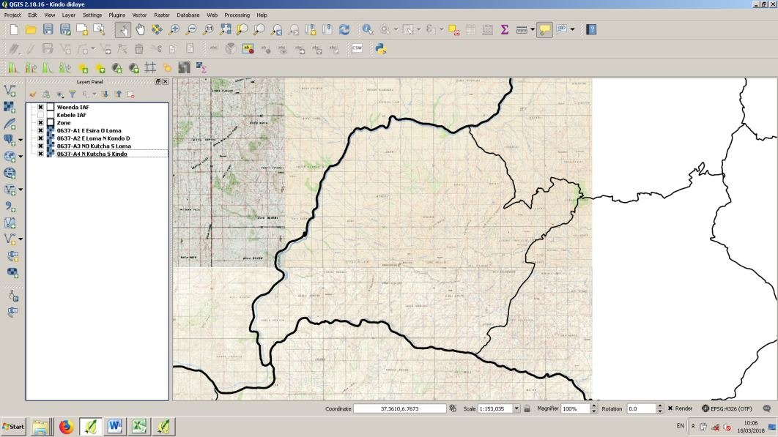
QGIS
Zoom in and out
The Hand
Refresh
Measure distance between two points
Layer panel
Hide or show layer
Add CSV file

Slide 3
Showing GPS points on the map
Open Garmo network.GPX as excel file
Delete unnecessary columns, add name of waypoints

Slide 4
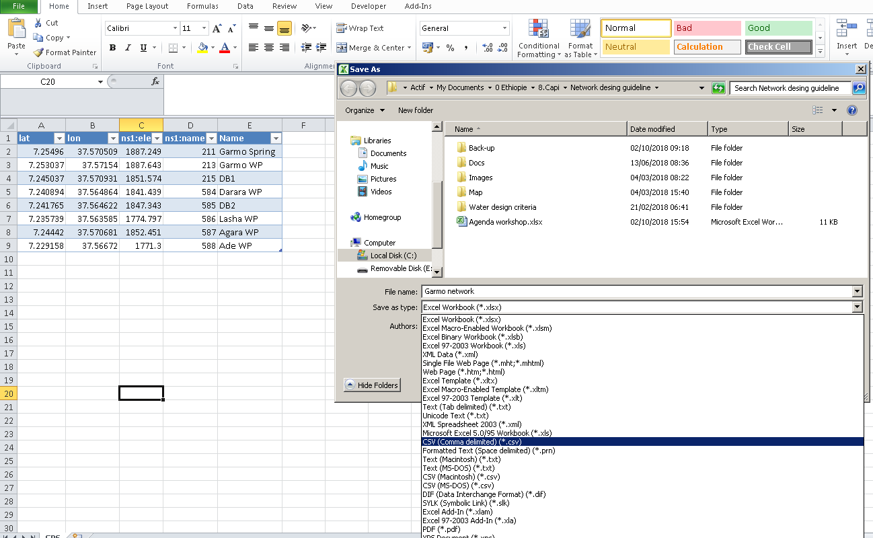
Save as CSV

Slide 5
Open CSV on QGIS
Click on Add Delimited Text Layer
Choose your file by clicking on broose
Then OK.

Slide 6
New layer appears in the layer panel
Points appear in the Kebele where you took the GPS points

Slide 7
Right click on the layer → Properties

Slide 8
Style → Choose the point color

Slide 9
Labels → show label for this layer

Slide 10
Label with → Choose column with structure name

Slide 11
Arrange the label:
Text: Change color

Slide 12
Arrange the label:
Buffer: Draw text buffer

Slide 13
Arrange the label:
Placement: Put 1 as distance

Slide 14
Modify the CSV file
You can make direct modifications on the CSV file.
You need then to click on refresh on QGIS

Slide 15
Draw the pipeline
Layer
→Create layer
→ New shapefile layer

Slide 16
Draw pipeline
Click on line
Give a name to the layer
OK

Slide 17
Name the file
Click Save
The new layer will appear in the control panel

Slide 18
Right click on the new layer → Toogle editing

Slide 19
Click on Add Feature
Click on pipeline start then pipeline end
Right click
Click OK

Slide 20
To move an existing line: Node tool
When line is drawn, click on toogle editing and save
To change line color: right click on Garmo pipeline in the layer panel → Properties → Style

